Slide 1

HOSPITAL EQUIPMENT PROCUREMENT ANALYSIS
Abimbola Giwa​​

Slide 2
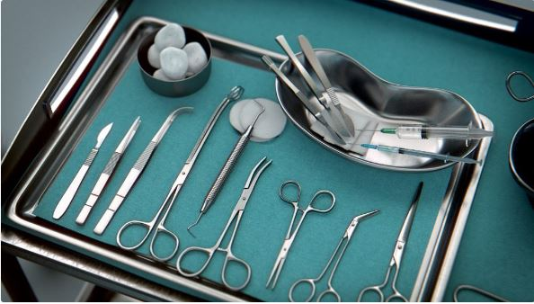
background
The Federal Ministry of Health, requires efficient management of equipment procurement to ensure the availability of necessary resources for patient care.

Slide 3
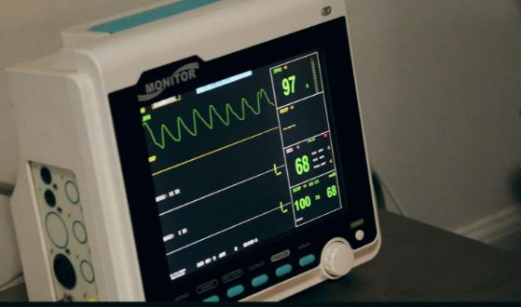
OBJECTIVES
Identify patterns, trends, and opportunities for optimization in equipment procurement processes.
Analyse supplier performance.
Identify cost optimization opportunities.
Identify equipment maintenance requirements.

Slide 4

data description
The dataset contains information on hospital equipment procurement, including details such as hospital name, location, equipment type, quantity, unit price, supplier information, order dates, delivery dates, warranty periods, maintenance costs, installation costs, and equipment conditions.

Slide 5
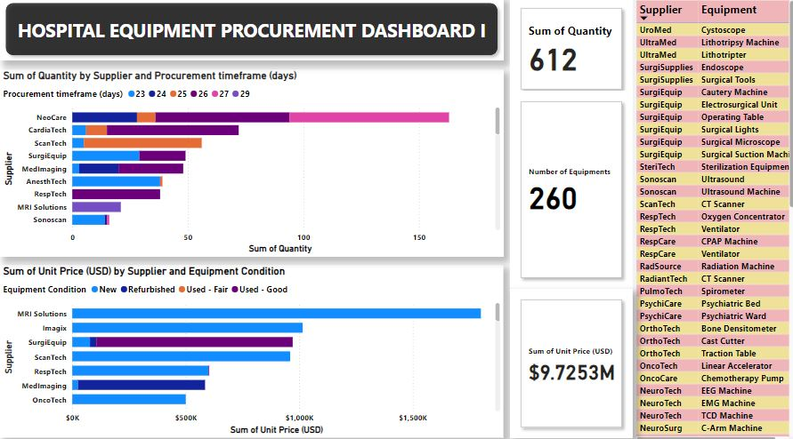

Slide 6
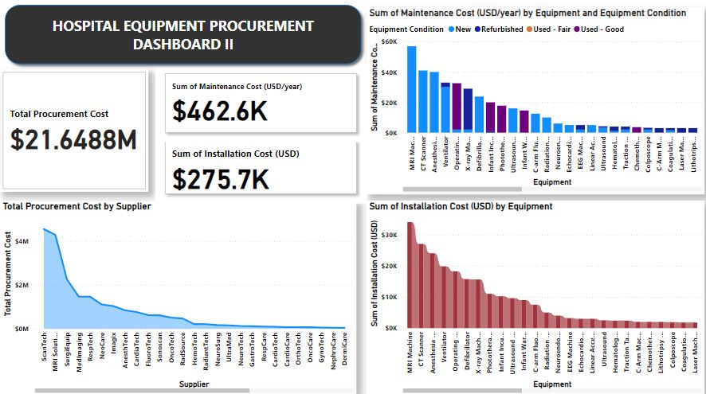

Slide 7
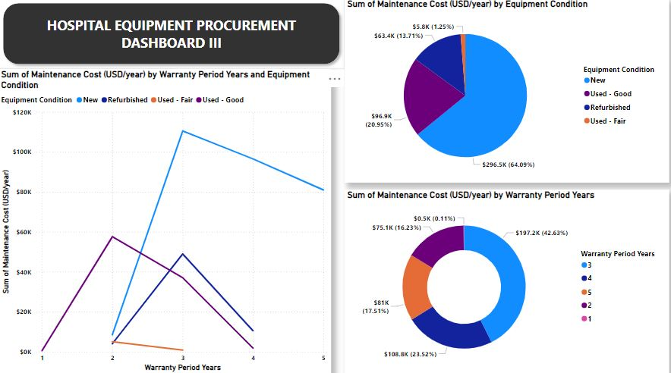

Slide 8
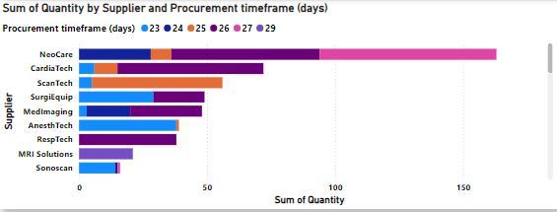
SUPPLIER EVALUATION
NeoCare supplied 4 equipments, totalling 163 in quantity, which is the largest.
They were able to deliver these equipments to their respective destinations between 24 and 27 days.
Unlike MRI Solutions that supplied only 1 equipment, totalling 21 in quantity.
They delivered their equipments in a much longer time frame of 29 days.

Slide 9
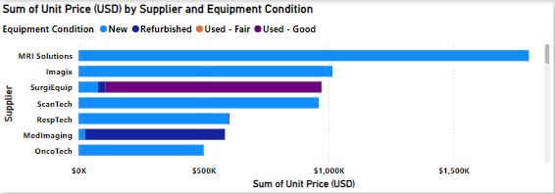
SUPPLIER EVALUATION
The top 5 suppliers that supplied new equipments are MRI Solutions, Imagix, Scan Tech, Resp Tech and Onco Tech
But MRI Solutions ranked the top position because their equipments were the most expensive at the rate of $1,800,000

Slide 10
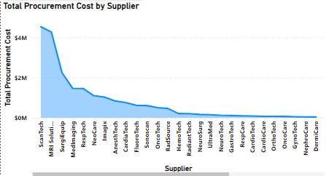
cost analysis
Scan Tech has the highest procurement cost of $4,540,000
MRI Solutions, taking the second place on the chart, have their procurement cost to be $4,272,000
The least expensive procurement cost is from the supplier: BioTech of $6,700

Slide 11
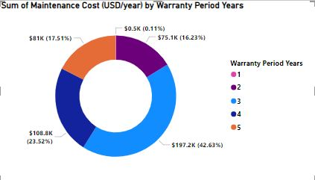
WARRANTY analysis
Equipments with 3 years warranty have the highest maintenance cost at $197,200
While equipments with only 1 year warranty have the least maintenance cost of $500

Slide 12
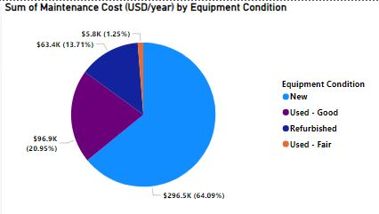
EQUIPMENT CONDITION analysis
New equipments have the highest maintenance cost of $296,500
While Used-Fair equipments have the least maintenance cost of $5,800

Slide 13
recommendations
The Federal Ministry of Health should consider NeoCare as a reliable supplier because they were able to supply the largest number of equipments at a short time frame, thereby reducing logistics cost.
New equipments are the most expensive, and also with the highest maintenance cost, so I would recommend the Used-Good equipments (as they are still in very good conditions) for their lower maintenance and installation cost.
A
I would also recommend going for equipments with 4 or 5 years warranty periods for their lower maintenance cost
Thank you.
B

